Slide 1
Project on Bayesian algorithm Machine learning method

Slide 2

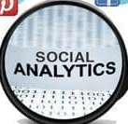
How can we predict the popularity of our media posts?
Which platforms will maximize our outreach?
Probabilistic Learning and Classification
Our goal is to strategically increase our interactions across platforms

Slide 3



Our Data Set and Naive Bayes
We collected a data set with 90,000 observations of news headlines across 3 platforms:
Naive Bayes Strengths
Simple, fast, and very effective
Works well with very large numbers of examples
Easy to obtain the estimated probability for a prediction
Implemented Popular & Unpopular parameters
Source: Lantz, B. (2019). Machine learning with R: Expert techniques for predictive modeling. Birmingham: Packt Publishing.
Source: Index of /ml/machine-learning-databases/00432/Data (uci.edu)

Slide 4
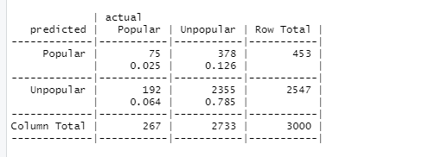
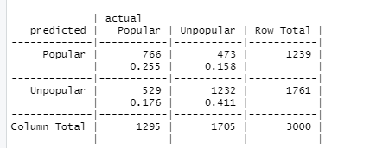
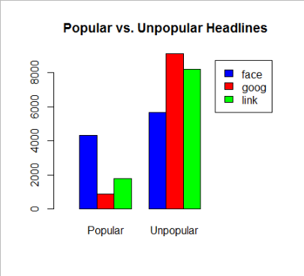
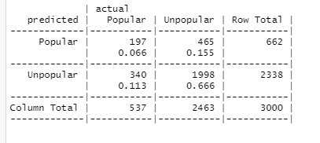
Summary of the Data Set : Descriptive Statistics
81% Accuracy
67% Accuracy
GooglePlus
Facebook
LinkedIn
The accuracy of our model varies across platforms
Continued
73% Accuracy

Slide 5
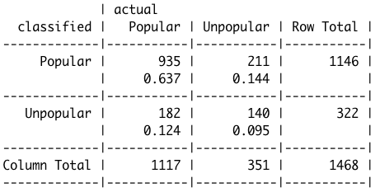
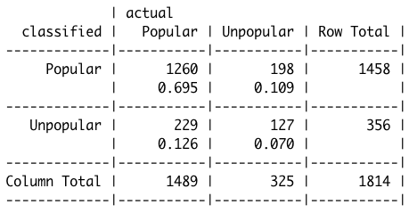
Summary of the Data Set : Descriptive Statistics
We looked deeper into subject matter analysis.
Using the Bayes algorithm… We targeted the topics “Economy” and “Microsoft” to predict the popularity of headlines containing the two topics. (separately)
Economy
Microsoft
73% Accuracy
76.5% Accuracy

Slide 6
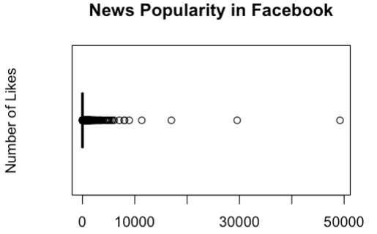
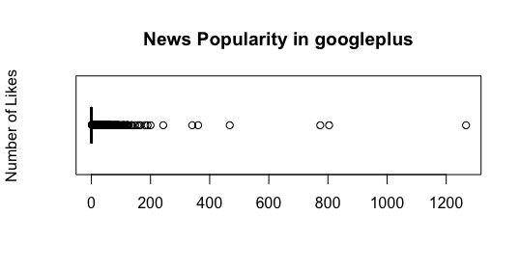
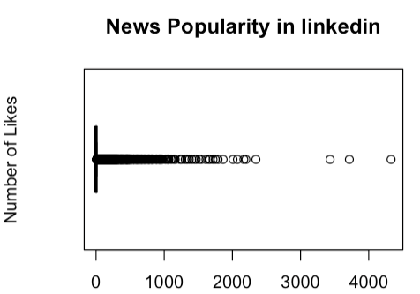
The sample data based on news popularity of two topics

Slide 7
Why the Bayes algorithm was chosen for our model
Our Data set is perfect for supervised learning
#1
#2
#3
“Bayesian classifiers are best applied to problems in which the information from numerous attributes should be considered simultaneously in order to estimate the overall probability of an outcome…”
“Bayesian probability theory is rooted in the idea that the estimated likelihood of an event, or potential outcome, should be based on the evidence at hand across multiple trials or opportunities for the event to occur “
Our team knew that this algorithm could be challenging but understood that the possibility to discover probabilities through out the data set could drastically improve our strategic marketing.
Source: Lantz, B. (2019). Machine learning with R: Expert techniques for predictive modeling. Birmingham: Packt Publishing.

Slide 8
How is our model useful?
With our model, our company will now be able to strategically market ourselves online. With the information collected + the interchangeable factors like “economy” or “Microsoft”, our company can now predict the popularity of our media posts.
Furthermore, we now have clarity of which types of headlines succeed across the 3 platforms.

